Slide 1
COMMUNICATIONS
GUIDE
How to talk Movember at work

Slide 2
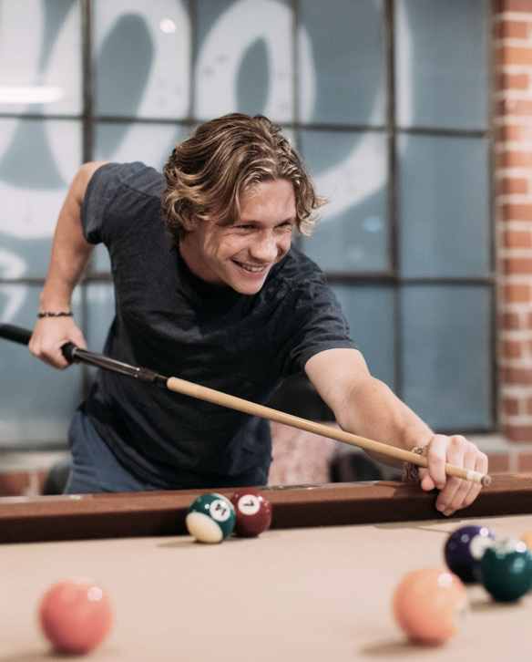

This guide is your one-stop shop for key Movember resources that make engaging and communicating with your workplace as easy as ever.
SLIDE 03 INTRANET | SLIDE 07 INTERNAL CHANNELS | SLIDE 09 MO SPACE MESSAGING | SLIDE 11 EMAILS
CONTENTS

Slide 3
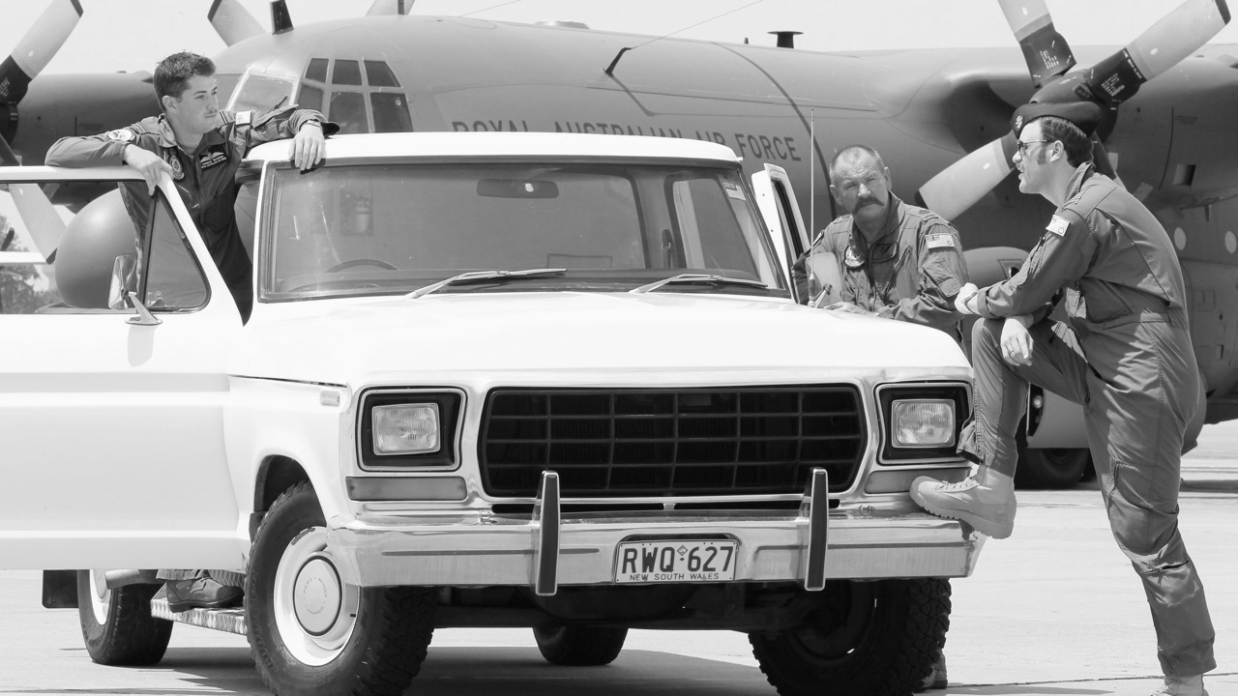

INTRANET

Slide 4
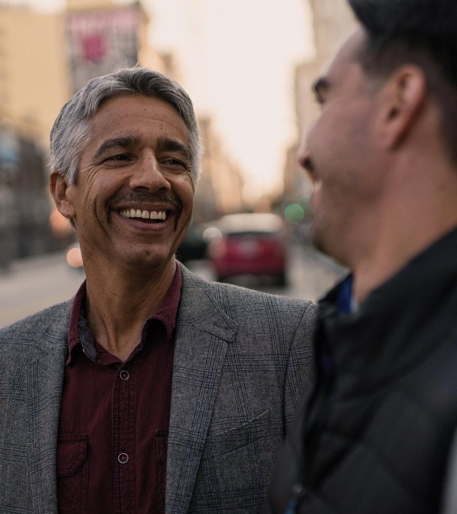


CORPORATE SUPPORT
ACTS AS ROCKET FUEL FOR YOUR CAMPAIGN.
Take a second to imagine the impact if:
Your fundraising was doubled (or tripled!) by a corporate dollar match or corporate cheque
Your CEO or President made an announcement pledging their support and encouraged the whole company to join you
You were given budget to host a month-end wrap up party for the entire office
Your communications team helped promote and share Movember mental health messages internally
Movember is the leading global charity changing the face of men’s health. They exist to stop men dying too young by tackling some of the most complex health issues facing men today – mental health, suicide, prostate cancer and testicular cancer.
Thanks to the seven million people globally who have got behind the movement, Movember is proud to have funded more than 1,300 men’s health projects around the world. Programs that challenge health systems, confront gender norms, reduce health inequalities, and encourage men to adopt healthy behaviours.
They will continue to make noise, push boundaries, and shape the health and wellbeing of men for generations to come. Because healthier men means a healthier world.
ABOUT
MOVEMBER

Slide 5

THE STATS
On average,
men are dying
Globally we lose
one man to suicide
Testicular cancer is the most common cancer in men
Prostate cancer is the most common for men
4.5
YEARS
EVERY MINUTE
AGED
15-34
OVER
45
earlier than women, and for largely preventable reasons
of every hour of every day

Slide 6
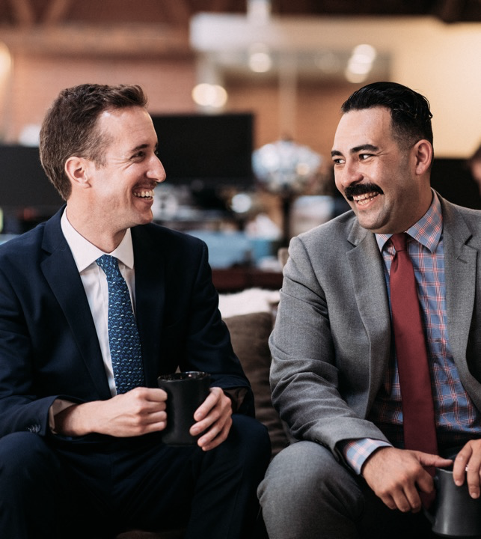
THE STATS
On average, men are dying
GROW A MO
HOST A MO-MENT
Even if you can’t grow a showstopper, don’t worry: the worst moustaches start the best conversations.
Rally a crew and do something fun. Hosting is all about having a good time for a good cause.
4.5 YEARS
earlier than women, and for largely preventable reasons
MO YOUR OWN WAY
MAKE A MOVE
A choose-your-own-adventure challenge, epic in scope and scale. You set the limits and chase them down.
Globally we lose one man to suicide
Run or walk 60kms over the month of Movember. That’s 60kms for the 60 men we lose to suicide each hour, every hour, across the world
EVERY MINUTE
Don’t forget to join our team here:
<add a hyperlink to your team page in black text, you could even use your QR code found on your Mo Space>
earlier than women, and for largely preventable reasons
HOW YOU CAN GET INVOLVED

Slide 7
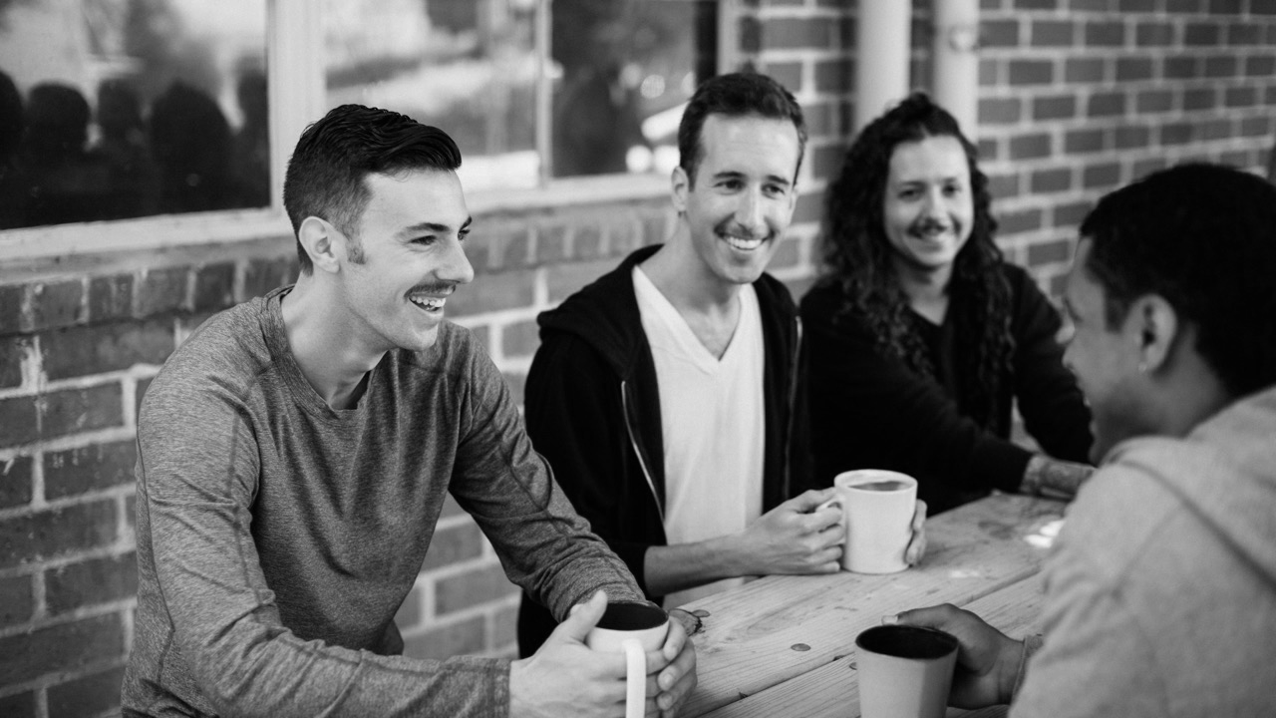
INTERNAL CHANNELS

Slide 8
Here’s some ideas for those internal workplace channels like Slack, Veeva Engage and Teams
POST 01
POST 02
POST 03
POST 04
Movember is nearly upon us and we want you to join our team. You can Grow a Mo, Move 60km for the 60 men we lose to suicide every hour, Host an event or Mo Your Own Way and choose your adventure. However you take part, you’ll be helping to change the face of men’s health.
Movember exists to stop men dying too young by tackling some of the most complex health issues facing men today – mental health, suicide, prostate cancer and testicular cancer. By joining our team, you can help tackle them too. Head to our team page to help us kick off the hairiest time of the year
<insert team page link>
Did you know that globally we lose one man to suicide every minute of every hour of every day? Or that testicular cancer is the most common cancer in men aged 15-34?
That's why this year and every year, we tackle Movember for our dads, grandads, partners, brothers, sons, friends and colleagues.
The best part? It’s not too late to join our team. Head to our team page to check us out and join in the hairy madness.
<insert link>
Movember is in full swing and we’re officially past the halfway point. Please take a Mo-ment to join me in celebrating some exceptional efforts from our team:
TOP FUNDRAISER
<Insert name and $ raised>
MOST CREATIVE FUNDRAISER <Insert name and idea>
BEST MO
<Insert name and photo>
BEST MOVER
<insert name of the person logging the most KMs>
Check out the full team here
<insert link>
*Sigh*
Movember is officially over. What a month it’s been. To everyone who took part, donated, complimented our moustaches and cheered on our movers, thank you.
As a team we raised $X to change the face of men’s health. We know that healthier men equals a healthier world and we’re proud to champion the fun and the serious side of Movember.

Slide 9
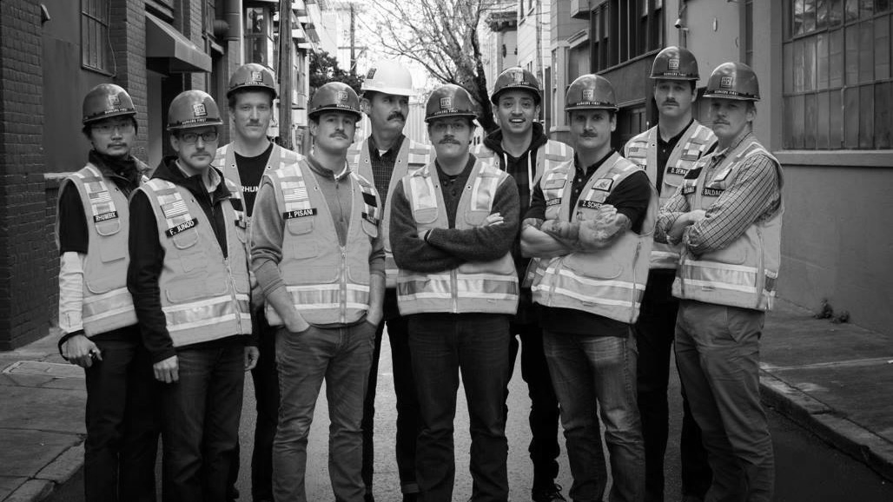
MO SPACE MESSAGING

Slide 10

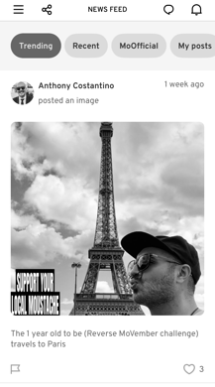
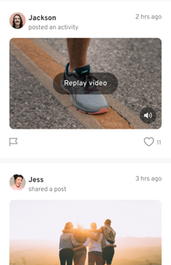

This year we’ve got a new feature in the Movember app where you can directly message your team. Simply download the Movember app, login, click on your feed and then hit the speech bubble icon (top right).
MESSAGE 01
MESSAGE 02
MESSAGE 03
Welcome to the team
Welcome to the team everyone! Stoked to have you on board for Movember 2025. Things are about to get hairy and I can’t wait. If you haven’t already, make sure you jump into your Mo Space, upload a photo, update that bio and set your fundraising goal.
Better yet, recruit another workmate to join us! Remember that all funds you raise will help to change the face of men’s health for the men in your lives you love and care about.
Keep it up
(adjust depending on how
your team is taking part)
Team I am loving seeing these progress updates from all of you. Plenty of KMs logged and some hairy upper lips beginning to look like they could one day be beautiful moustaches.
Keep them coming because your donors love to see them too. Don’t forget we’ve got out event coming up, can’t wait to see you there.
Thank you, legends
Team, I couldn’t be prouder of your efforts this Movember. We’ve made it. The conversations you’ve started, awareness created and dollars raised will all help support men to lead healthier and longer lives.
Don’t forget to chase up those last donations over the next few days and reflect on what a great month it’s been. A big thanks to each and every one of you.

Slide 11
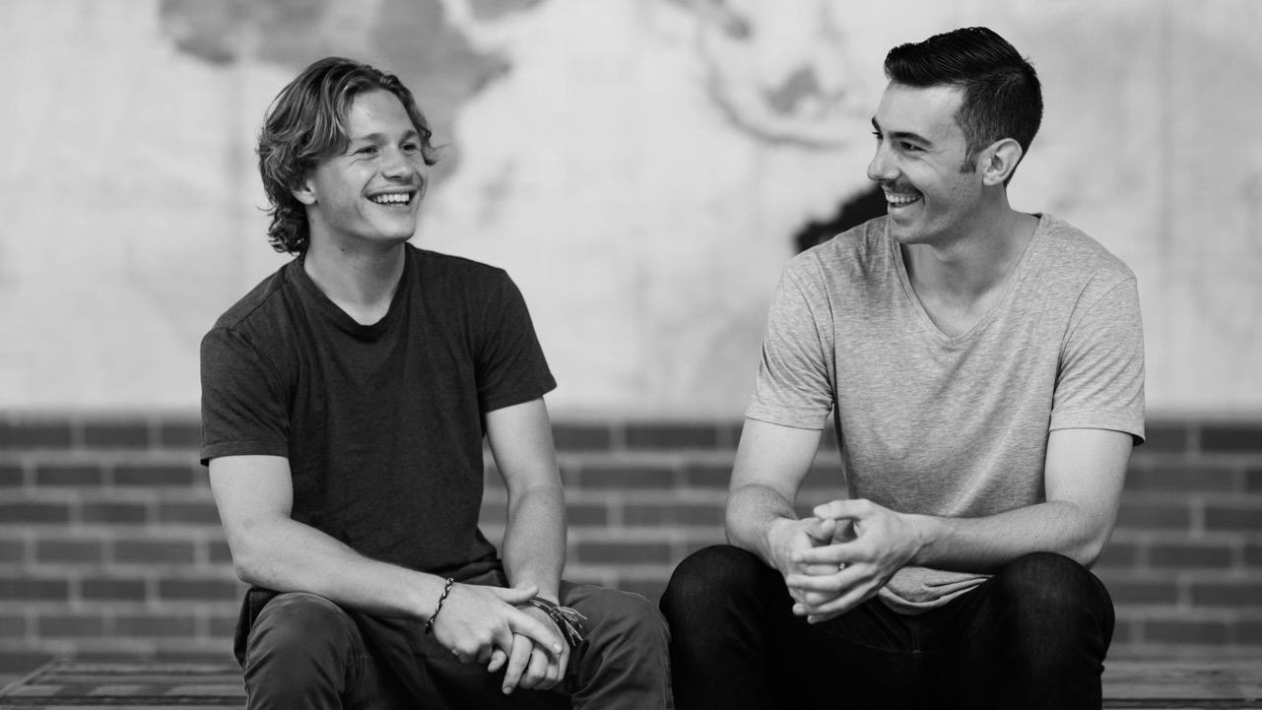
EMAILS

Slide 12
The dates mentioned
are purely suggestions
– feel free to send your emails whenever works best for you.
We encourage you to
edit the messages to reflect the needs, goals, strategy, and all-round vibe of your audience.
Feel free to use as many or as few of the templates as you’d like – they’re yours to make your own.
To email a list of last year’s team members go to your team Mo Space, click ‘recruit and manage’, then ‘invite’.
PS. don’t forget to check out our e-signatures and other resources you might like to add to your emails here.
SUGGESTED SEND DATE
SUBJECT
WHO YOU MIGHT SEND THIS TO
THEME
MID OCTOBER
Join our Movember team
The masses, the more the merrier
Join us
and what is Movember
LATE OCTOBER
Ready, set, Mo!
The masses, make sure you include a last push to previous team members of last year too
Last change to join the team
1ST NOVEMBER
Things are getting hairy
Your team
Week one wrap
MID NOVEMBER
Halfway there
Your team
We’re halfway
HOW TO USE THESE EMAILS
LATE NOVEMBER
You’re changing the face of men’s health
Your team
One last push
EARLY DECEMBER
Thank you
Your team (better yet, shout out to the masses).
Thanks for Mo’ing with us

Slide 13
EMAIL 01
Hi team,
The month formerly known as November is nearly upon us and the Mo is calling.
We’d love to have you join our Movember team this year. The campaign is so much more than growing moustaches and anyone can be involved. It’s about supporting the men in our lives we care about to lead healthier, longer lives.
WHAT IS MOVEMBER?
Movember is the leading global charity changing the face of men’s health. They exist to stop men dying too young by tackling some of the most complex health issues facing men today – mental health, suicide, prostate cancer and testicular cancer.
On average, men are dying 4.5 years earlier than women, and for largely preventable reasons. We want to do something about that.
HOW TO GET INVOLVED
Grow a Mo. Even if you can’t grow a showstopper, don’t worry: the worst moustaches start the best conversations.
Make a Move. Run or walk 60kms over the month of Movember. That’s 60kms for the 60 men we lose to suicide each hour, every hour, across the world.
Host a Mo-ment. Rally a crew and do something fun. Hosting is all about having a good time for a good cause.
Mo Your Own Way. A choose-your-own-adventure challenge, epic in scope and scale. You set the limits and chase them down.
NEXT STEPS
Sign up to Movember and join our team here <insert hyperlink to team page>
If you have any questions just reach out.
United we Mo,
Subject
JOIN OUR
MOVEMBER TEAM

Slide 14
EMAIL 02
Team,
Did you know that globally we lose one man to suicide every minute of every hour of every day?
Or that testicular cancer is the most common cancer in men aged 15-34?
That's why this year and every year, we tackle Movember for our dads, grandads, partners, brothers, sons, friends and colleagues.
And it all kicks off shortly which means things are about to get Hairy. Well actually they’re about to get un-hairy because our growers will be shaving down tomorrow to get to work on their Mo’s. Be sure to get behind your fellow growers, movers and all of our team taking part this Movember.
The best part? It’s not too late to join our team. Head to our team page to check us out and join in the fun. <insert link> If you’re not taking part this year then we’d love your support through a donation to the team. You can do so via the same link.
Can’t wait to Mo with you,
Subject
READY, SET, MO!

Slide 15
EMAIL 03
Team, the big day is here. Welcome to Movember!
Our hairy journey is officially underway. It’s time to shave down then get growing, moving, planning and all round creative to help change the face of men’s health.
For those that have joined the team, thank you! Over the course of the next month, we’ll come together to raise funds and awareness for mental health and suicide prevention, prostate cancer and testicular cancer. We’ll also have a whole ton of fun while we’re at it.
Now that we’ve flipped the calendar to Movember, it is time to start bringing home the bacon. Below are a few tips to kickstart your fundraising journey:
01 Donate to yourself
Launch yourself off $0 with a donation to your Mo Space to help get the ball rolling. This will also help inspire others to give. If you donate $20 to yourself, you’ll notice the next person donates a similar amount.
02 Shout it out
Use social media to let people know how and why you are supporting Movember and men’s health.
03 Email your top 5-10 closest contacts
Start with the people who won’t say no. Parents? Siblings? Partner? Best friend?
This will help you build a bit of momentum and others will jump on board.
The Mo Train is leaving the station…all aboard!
Subject
THINGS ARE GETTING
(UN)HAIRY

Slide 16
EMAIL 04
Team,
We’re officially halfway through the mighty month of Movember!
By now you’ve surely seen the Mo’s sprouting and spreading all around you. While I recommend resisting the urge to touch or stroke your colleagues’ Mo’s, please don’t be shy when it comes to heaping on the praise. Don’t forget about our Movers either.
Speaking of praise, there have been some epic efforts and inspirational Growing, Moving, Mo Your Own Way-ing and Hosting through the first week. Please take a Mo-ment to join me in celebrating some exceptional efforts:
TOP FUNDRAISER <Insert name and $ raised>
MOST CREATIVE FUNDRAISER <Insert name and idea>
BEST MO <Insert name and photo>
BEST MOVER <insert name of person logging the most KMs>
Once again, thanks for being part of the team.
United we Mo,
Subject
HALFWAY THERE
OPTION 1
In addition to raising critical funds for men’s health, Movember is also about bringing people together. With that in mind, I wanted to remind everyone of the events we have planned over the coming weeks:
<Share what the event is, when and where to attend>
OPTION 2
In addition to raising critical funds for men’s health, Movember is also about encouraging open and honest conversations. With that in mind, I wanted to share why I Mo [share why you choose to get involved and support Movember]. What inspires you to get involved in Movember? Feel free to reply all or let me know directly.

Slide 17
EMAIL 05
<Greeting>,
We are well on our way down the home stretch of Movember and boy has our team been busy.
Now’s the time to dig deep for the final push!
<Insert team name> has raised a whopping $ <number> so far. I am proud to say we are officially a force to be reckoned with.
The leaderboard is full of legends and below are the current top 5 as we near the finish line:
<Insert name and $ raised>
<Insert name and $ raised>
<Insert name and $ raised>
<Insert name and $ raised>
<Insert name and $ raised>
There’s still time to knock these top-notch fundraisers off their perch. Consider this your invitation for a cheeky last minute leaderboard attack. With less than a week to go, the glory is there for the taking.
Use these last few days to hammer your channels with photos of your Mo-gress, updates on your Move, your event or your Mo Your Own Way challenge. DM, text, or email everyone you can think of and ask them to chip in to support you. Let them know what you’re doing and why – make it heartfelt and they’ll find it hard to say no.
As always, let me know if I can do anything to help.
Thank you for making this month so legend-hairy!
<Insert captain name>
Subject
YOU’RE CHANGING THE
FACE OF MEN’S HEALTH

Slide 18
EMAIL 06
Hi team,
Well, what do you know, Movember 2025 is done and dusted!
THANK YOU for your incredible efforts! Together we’ve done our part to help change the face of men’s health.
Here’s a brief summary of what <insert team name> accomplished this year:
<Insert # of teammates>
<Insert Team Funds Raised>
Special shoutout to our top 3 Fundraisers:
<Insert name and $ raised>
<Insert name and $ raised>
<Insert name and $ raised>
Congrats to everyone! Please take a moment to turn to your nearest fellow Mo and give them a fist bump, pat on the back, crisp high five or a thumbs up via Zoom. You all rock!
The funds you raised will help fund life-changing mental health programs, medical research and ground-breaking trials and cancer treatments. Not bad for a month’s work.
As we wrap up an awesome month, it’s also important to thank your donors. A handwritten note goes a long way, or even a personalised shoutout on social media. Make them feel the love!
I can’t thank you enough for getting on board. I’m so proud to call you my teammates.
Here’s to you, <Insert Team Name> Mo’s! Until next Movember!
<Insert Captain Name>
PS. While the hairy month has come to an end, don’t be afraid to chase up any strays or stragglers as there is still time to get last-minute donations to your Mo Space.
Subject
THANK YOU

Slide 19
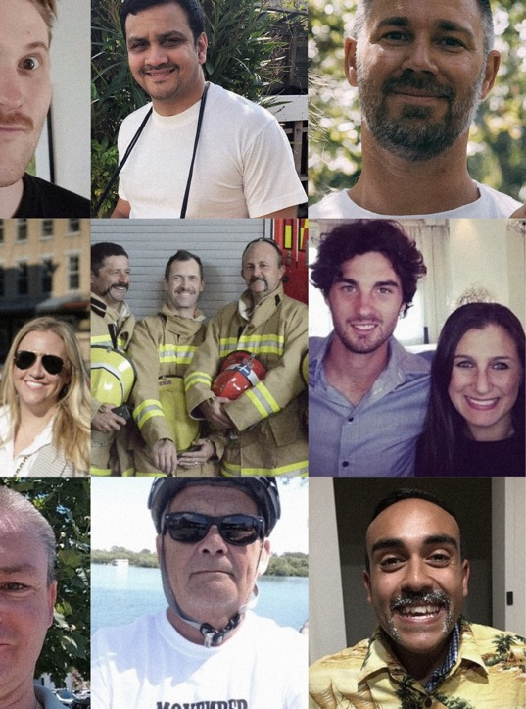
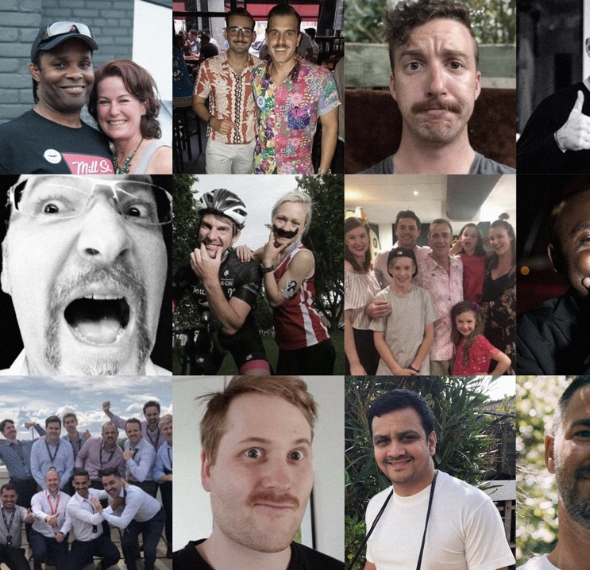

LET’S MO

